Slide 1
GROUP 2
ADU-BOADI, Prince 1841522
ALHASSAN, Saeda Nasara 1843422
ABOTSI, Agbeko Selasi 1840322
ADUKO, Lydia 1841622
AMOAKO, Julius Odame 1844022 ACHEAMPONG, Marvin Adu 1840422
ADUSEI, Benedict Frankson 1841722
AMOATWO, Agnes 1844122
ACQUAH, Maureen Abena Korantema 1840522
ADUTWUM, Ama Kudom 1841822

Slide 2
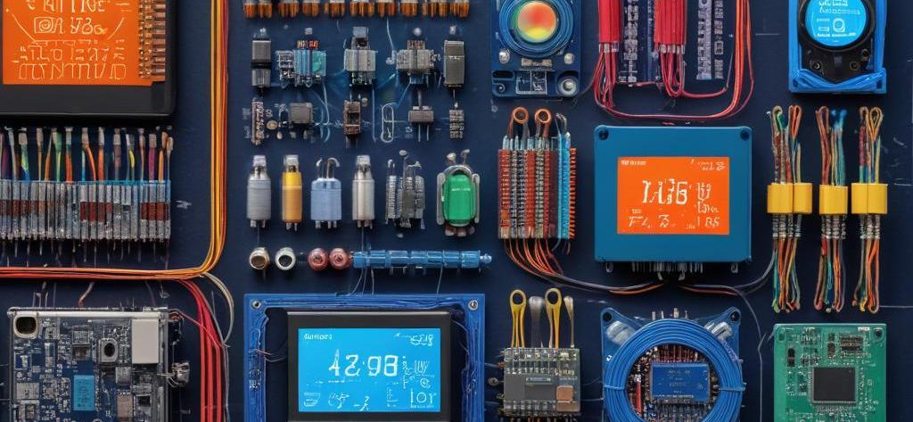
TABLE OF CONTENT
PROBLEM STATEMENT
METHODOLOGY
. Approach
. Code & Schematic
DEMONSTRATION
CONCLUSIOM
ADDITIONAL INFORMATION

Slide 3
01 PROBLEM STATEMENT
Maintaining safe pool water quality is crucial for health and hygiene.
Factors affecting water quality:
1. pH levels - Too acidic or too basic can be harmful
2. Temperature - Too high can promote bacteria growth
3. Turbidity - Cloudy water may indicate contaminants
Objective: Develop a system that monitors pool water quality and alerts users when conditions are unsafe

Slide 4
02
METHODOLOGY

Slide 5
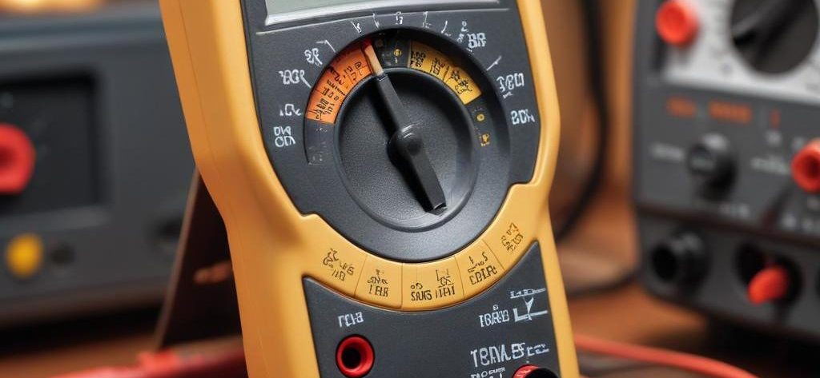
METHODOLOGY
Used sensors to measure pH, temperature, and turbidity.
Processed sensor data with a microcontroller (Arduino, if applicable).
Displayed real-time readings on an LCD screen.
Triggered a buzzer and LED indicators if values exceeded safe limits.

Slide 6
Potentiometer as pH Sensor
The potentiometer serves as a pH sensor, where its resistance changes correspond to varying pH levels from 0 to 14. The calculation used is (14/1023) multiplied by the value read from the analog pin. This conversion allows for the determination of the pH level based on the voltage output from the potentiometer.

Slide 7
Photo Resistor for Turbidity
The photo resistor functions as a turbidity sensor by measuring the amount of light that passes through a sample. When the water is clear, more light is allowed through, resulting in lower resistance and higher voltage readings (around 4.5V). Conversely, if the water is turbid, less light passes through, leading to higher resistance and lower voltage readings (around 0.4V). The system interprets these values to quantify turbidity in the water.

Slide 8
This link contains the simulation of our project:
https://www.tinkercad.com/things/kRJu0u915FB-water-quality-checker/editel?returnTo=https%3A%2F%2Fwww.tinkercad.com%2Fdashboard&sharecode=NJBAEl35qfcqYEMqkEUSrhVd4e-Rpm-wuramtv9WrBw

Slide 9
02
Signal Processing

Slide 10
Voltage and Resistance Conversion
For both the photo resistor and potentiometer, analog readings are converted into a voltage range suitable for the microcontroller. The photo resistor converts light levels into a voltage output ranging from 0 to 5V, which is then scaled to a digital value between 0 and 1023 for processing. This enables accurate monitoring of light levels that relate to turbidity.

Slide 11
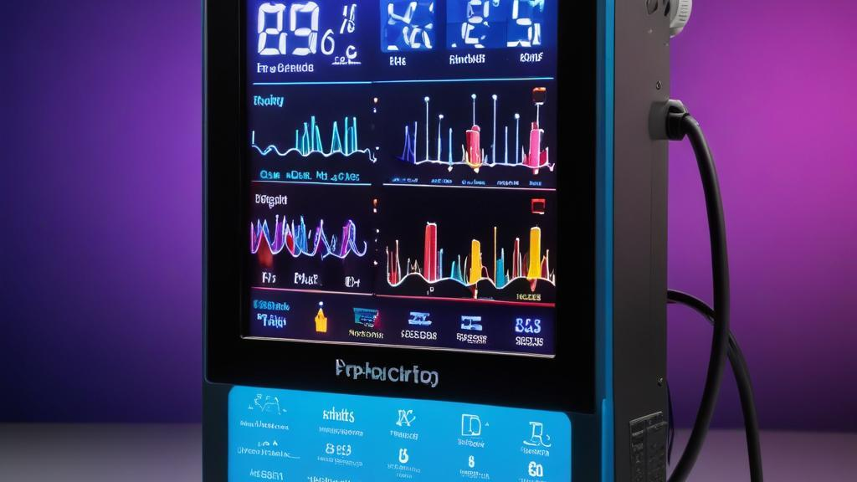
LCD Display Outputs
The LCD 16 X 4 displays the interpreted sensor outputs, showing pH levels, turbidity, and temperature readings. This provides real-time feedback on system performance and ensures users can easily access and visualize the data being collected by the sensors. Each sensor's output is updated to reflect current measurements, enhancing the interactivity of the simulation.

Slide 12
Buzzer Activation Conditions
The buzzer serves as an alarm mechanism, triggering under specific conditions: when pH readings fall below 6.5 or rise above 7.5, when temperature exceeds 30 degrees Celsius, or when turbidity exceeds a threshold of 70. These parameters ensure that critical changes in the environment are alerted, facilitating timely responses to conditions that may require attention.

Slide 13
CHALLENGES FACED:
We made use of Tinkercad for our simulation and unfortunately could not find a Ph sensor and Turbidity sensor.
HOW WE SOLVED THESE PROBLEMS:
We made use of a potentiometer whose varying resistance will emulate the different pH levels. We also solved the issue of the turbidity sensor by making use of a photoresistor considering the fact that if the water is clear(that is less turbid), the photoresister will receive more light and the opposite for when its is turbid.

Slide 14
Conclusions
The simulation effectively integrates various sensors, capturing environmental data such as temperature, pH, and turbidity. By employing signal processing techniques and displaying results on the LCD, the simulation demonstrates a comprehensive understanding of real-world applications of sensor technology.

